Slide 1
Week 5: Forecasting

Slide 2
Learning Objectives
Learn how to perform forecasting using Tableau.
Investigate and perform model comparison .
Perform Analysis responsibly.

Slide 3
Forecasting
Forecasting is a way of predicting the future by using historical data. This data is fed to a machine learning model to predict the future.

Slide 4
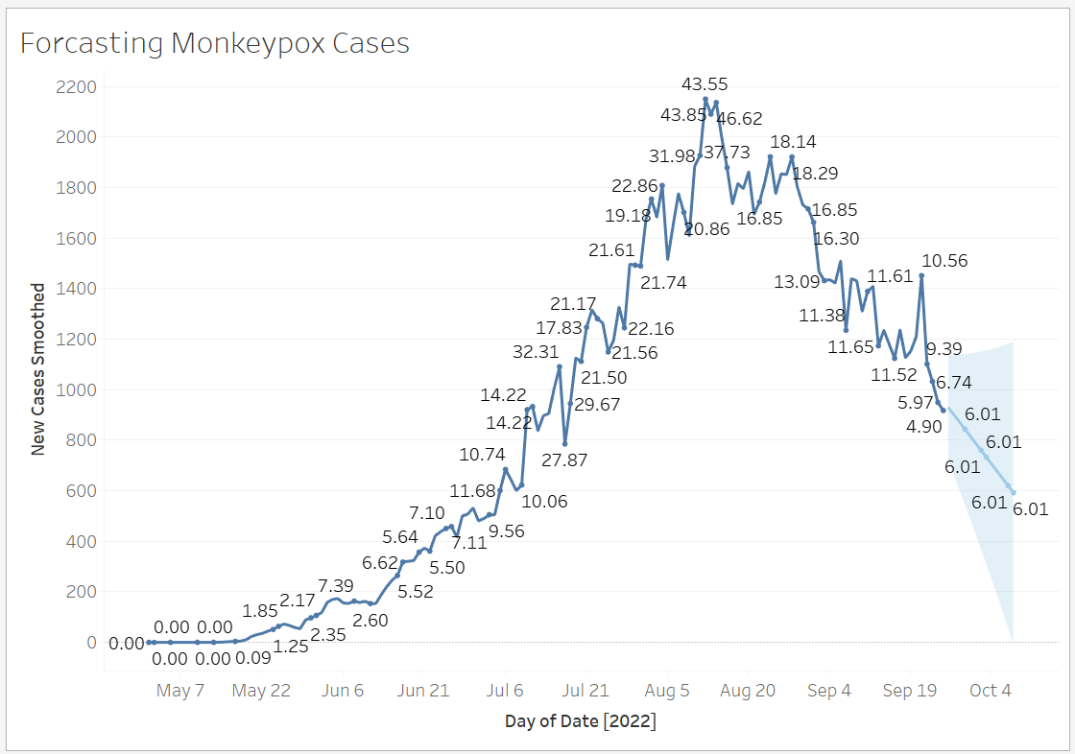
Forecasting in Tableau
Using Monkeypox data:
Create a line chart with Day (Date) in the Columns shelf and New Cases Smoothed in the Rows shelf.
Go to the Analysis tab and click on Forecast under Model category.
* You can add labels for clarity.
Notes:
https://btprovider.com/forecast-in-tableau/

Slide 5
Actual vs. Forecast Data
If actual vs. forecast data is being displayed, the line must display the data using different types of lines.
Leverage preattentive attributes to signal to the viewer “something is different, look here.”

Slide 6
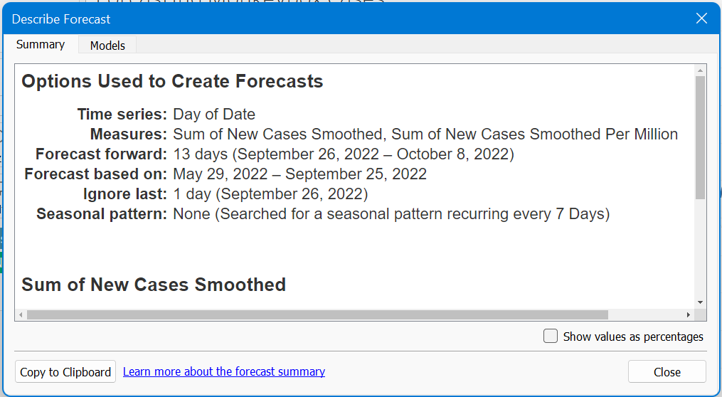
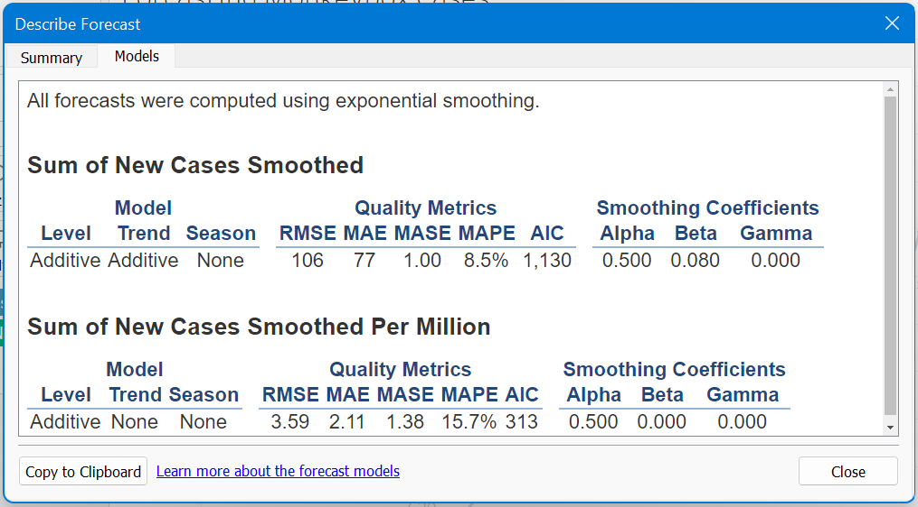
To learn more about the forecast (from Describe Forecast…)

Slide 7
Regression and correlation
Correlation quantifies the strength of the linear relationship between a pair of variables, whereas regression expresses the relationship in the form of an equation.

Slide 8
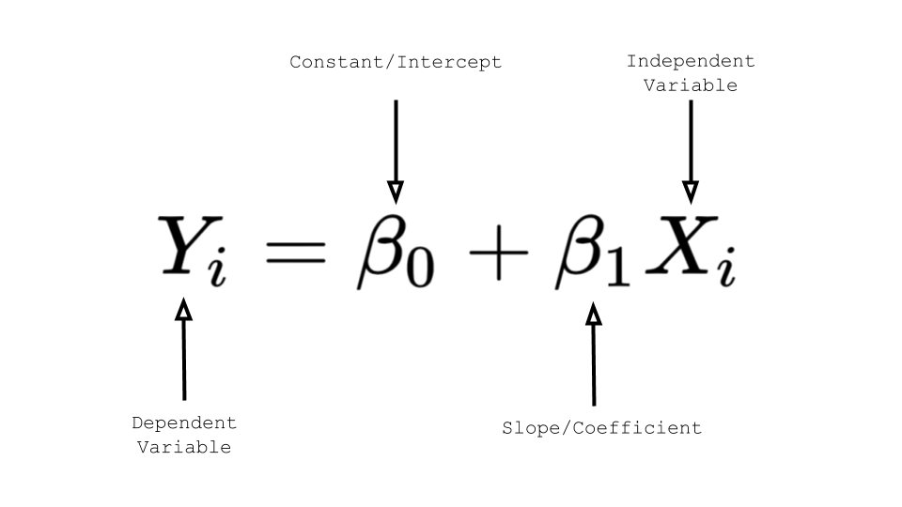
The Linear Regression Equation
X is the independent variable and Y is the dependent variable. The slope of the line is b1, and b0 is the intercept.
The slope tells us how rapidly Y changes with respect to X.
The intercept is the mean value of Y when X is zero.

Slide 9
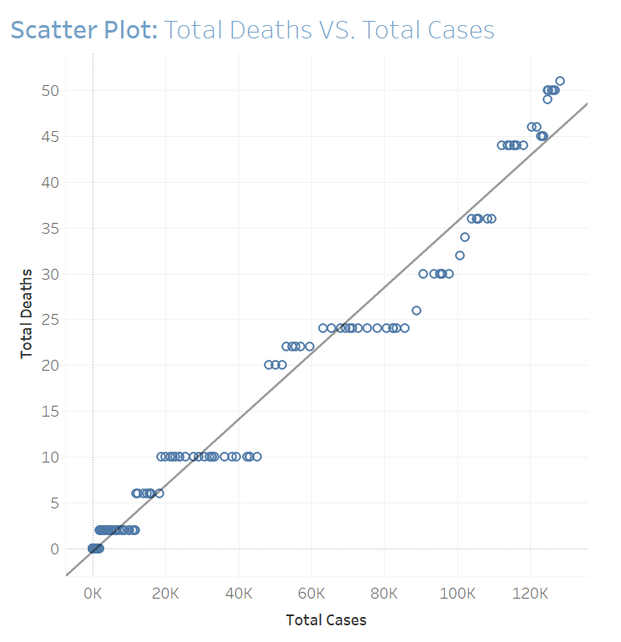
Linear Regression in Tableau
Using Monkeypox data:
Create a Scatter Plot with Total Cases in the Columns shelf and Total Deaths in the Rows shelf.
Go to the Analysis tab and click on Trend Line (Linear) under Model category.

Slide 10
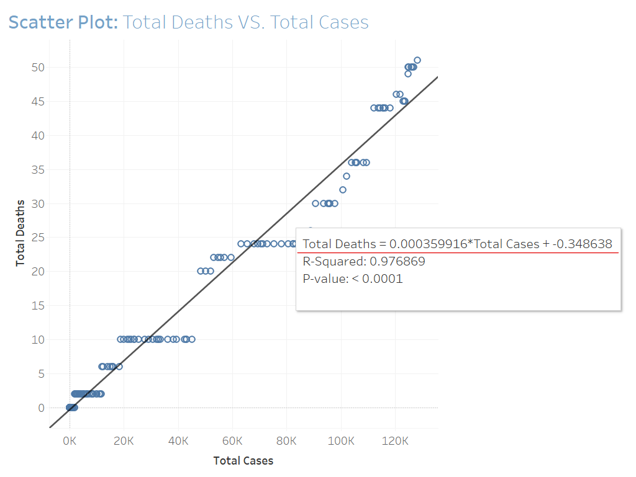
Linear Regression in Tableau
Regression equation explained:
Total Deaths = -0.3486 + 0.00035* Total Cases
What does this mean?

Slide 11
Thank you!

